Slide 1
Needles in the Haystack Google and Other Brokers in the Bits Bazaar
Presentation by: Abhinav Suri

Slide 2
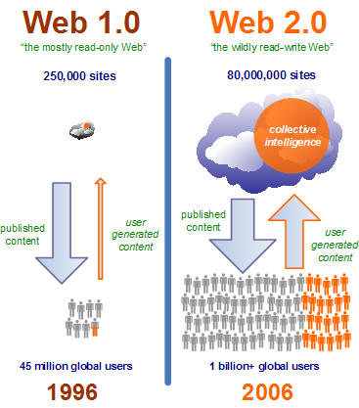
Beginnings and Web 1.0 -> Web 2.0
Universities and EDU organization/military held access to scholarly articles on the an early form of the internet
NO “REAL” SEARCH ENGINE
Essentially just a bunch of directories
A “Yellow Pages” of the internet
Now the web is linked together by search engines
Regular people are now contributing to websites to create “network effect” (think FB, and Wikipedia)

Slide 3
Search and Zeitgeist
“Search is a new form of control over information”
Provide an automatically indexing hierarchical search database
Concerns:
Search engines such as Google take search data and compile it into a Zeitgeist (a huge compilation of the most popular search trends and terms)
What is Google hiding from us? How does it work in regions where censorship is common?

Slide 4
Big Stuff
When you search:
Results differ search engine to search engine
Web is huge, the ~250k results you get is hardly a drop in the pond
How do you sort all of this
What influence do companies have over results?
Vannevar Bush (Director of Office of Strategic Research and Development) during WWII said that
“The difficulty seems to be, not so much that we publish unduly…but rather that publication has been extended far beyond our present ability to make real use of the record”

Slide 5
How do?
Gather info
Keep copies
Build an index
Understand the query
Determine the relevance of result to query
Determine ranking
Present the results

Slide 6
Gather & Copy
Spiders and Crawlers
Only 3% of the web has been indexed so far
HTML hierarchy <h1></h1> Most important and <meta> tags help
More important a website is, the more it gets indexed
Crawlers will keep a copy of a webpage
Issues w/deleted pages
No info is truly hidden

Slide 7
Indexing, Querying, and Relevance
Store all data in DB centers
Can be very large, but its only text
Queries are tough for computers to understand, which is why you’ll get nonrelevant reuslts.
E.g. yankees beat red sox
- first goes thru in order
- then goes out of order
Results in some articles about red sox beating yankees

Slide 8
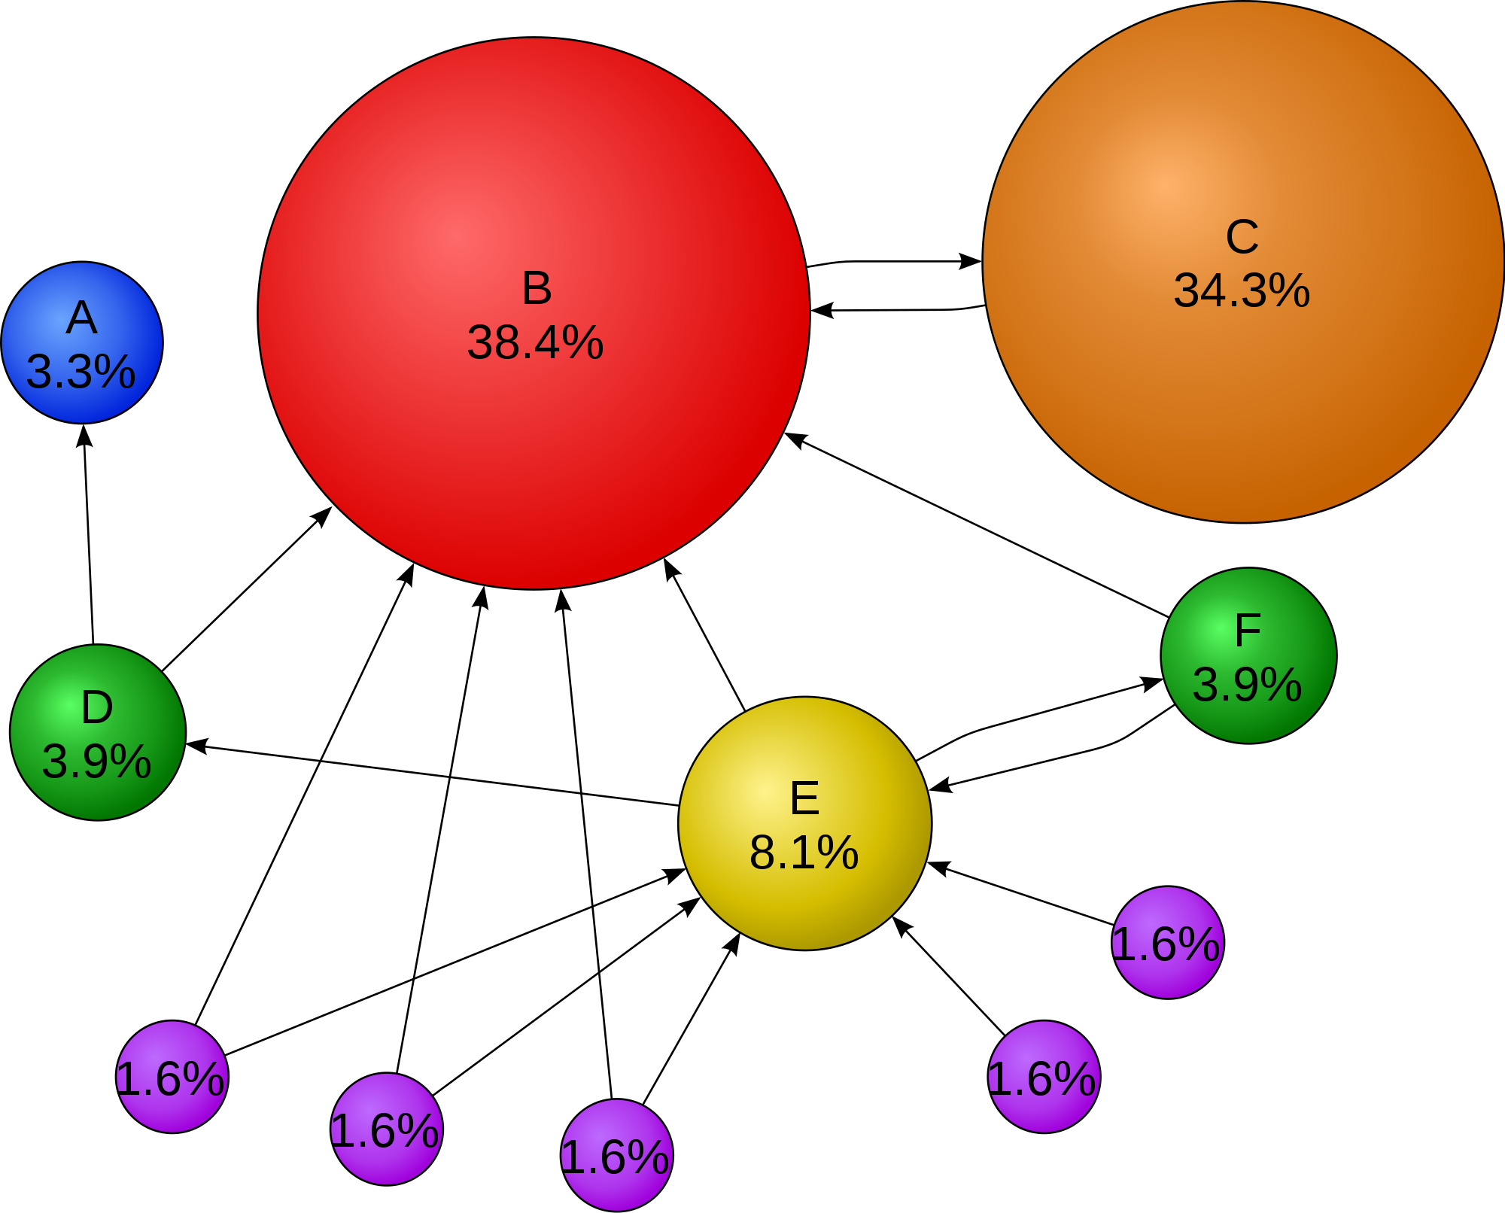
Ranking
“PageRank” Algorithm = more links that refer to your page the higher score you get (0-10)
Too many link refs outside page will decrease score
Pages that have low click thru rate are ranked lower
Pages with false advertising (hidden divs) are also penalized
SEO helps

Slide 9
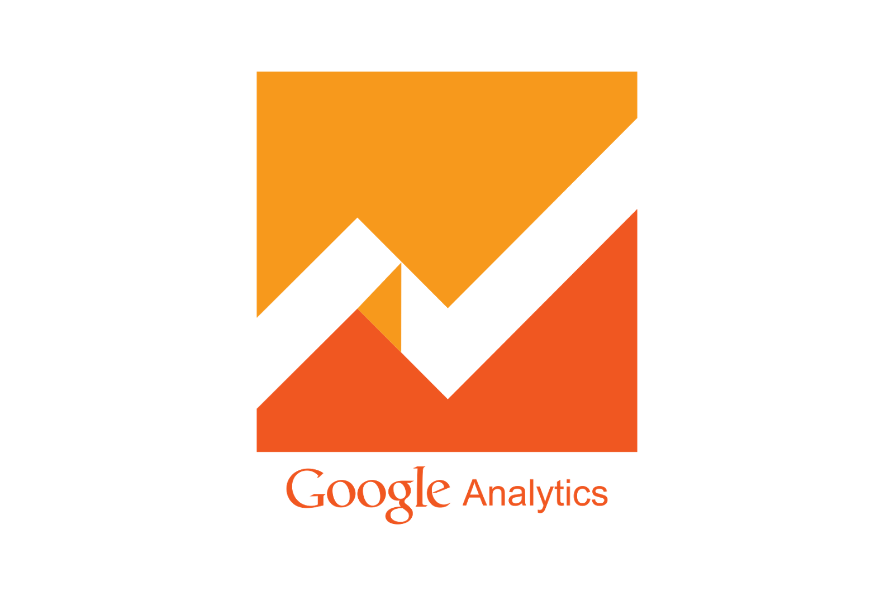
Advertising
Search engine has to make money to compensate employees and pay for costs of servers
4 payment schemes
User payment X
Websites pay to be discovered
Nonprofits pay X
Advertisers pay
Overture: Pay for each click, Pay to be ranked
Tech bubble burst made this too expensive
Pushback from Gov false advertising
ADWORDS FROM GOOGLE
Auction off key words. E.g. if someone searches “Cell phone” companies specify a max bid and whichever company is willing to pay the most, gets the top slot

Slide 10
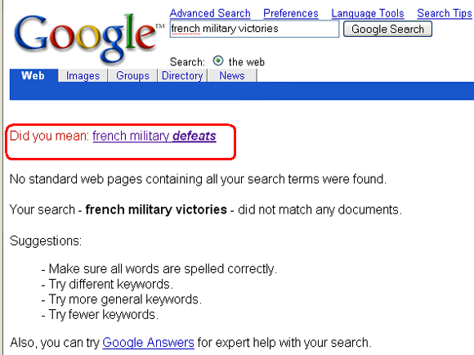
Search Can Mess Up
Takes trends and uses them when making suggestions.
E.g. amazon fiasco: people searching for books about abortion would get suggestion “Did you mean books about adoption?”
“Google Bombing” get enough users to get a particular search to return wrong results (e.g. “miserable failure” > biography of George Bush)
Blog Spammers
CAPTCHA used to prevent it (Completely Automated Public Turing test to tell Computers and Humans Apart)

Slide 11

Different Search Engines and Censorship
Somewhat rare for different search engines to return the same results.
Everyone has a different search algorithm etc
Search engines can banish results as it sees fit
Google v Google China
PATRIOT Act and PRISM requires google to turn in search queries as necessary

